Slide 1
Cognitive Approach: George Kelly
Personality Psychology

Slide 2
Personal Construct Theory
Kelly suggested that people perceive and organize their world of experiences the same way scientists do, by formulating hypotheses about the environment and testing them against the reality of daily life. In other words, we observe the events of our life—the facts or data of our experience—and interpret them in our own way.
This personal interpreting, explaining, or construing of experience is our unique view of events (Winter & Proctor, 2014).
It is the pattern within which we place them. Kelly said that we look at the world through “transparent patterns that fit over the realities of which the world is composed” (Kelly, 1955, pp. 8–9).
A construct is a person’s unique way of looking at life, an intellectual hypothesis devised to explain or interpret events.
We behave in accordance with the expectation that our constructs will predict and explain the reality of our world.
Like scientists, we constantly test these hypotheses. We base our behavior on our constructs, and we evaluate the effects.

Slide 3
Personal Construct
We might compare these patterns to sunglasses that add a particular tint or color to everything we see around us.
One person’s glasses may have a bluish tint, whereas another’s may have a greenish tint.
As a result, several people can look at the same scene and perceive it differently, depending on the tint of the lenses that frame their point of view.
So it is with the hypotheses or patterns we construct to make sense of our world.
This special view, the unique pattern created by each individual, is what Kelly called our construct system.

Slide 4
Constructive Alternativism
Over the course of our lives, we develop many constructs, one for almost every type of person or situation we encounter.
We expand our inventory of constructs as we meet new people and face new situations. Further, we may alter or discard constructs periodically as situations change.
Revising our constructs is a necessary and continuous process; we must always have an alternative construct to apply to a situation.
If our constructs were inflexible and incapable of being revised (which is what would happen if personality was totally determined by childhood influences), then we would not be able to cope with new situations.
Kelly called this adaptability constructive alternativism to express the view that we are not controlled by our constructs but we are free to revise or replace them with other alternatives.

Slide 5
Anticipating the life events
Kelly’s personal construct theory is presented in a scientific format, organized into a fundamental postulate and 11 corollaries.
The fundamental postulate states that our psychological processes are directed by the ways in which we anticipate events.
By using the word processes, Kelly was suggesting that personality was a continually flowing, moving process. Our psychological processes are directed by our constructs, by the way each of us construes our world. Another key word in the fundamental postulate is anticipate.
Kelly’s notion of constructs is anticipatory. We use constructs to predict the future so that we have some idea of the consequences of our actions, of what is likely to occur if we behave in a certain way.

Slide 7
Human Nature
Kelly’s personality theory presents an optimistic, even flattering, image of human nature (Kelly, 1969).
He treated people as rational beings capable of forming a framework of constructs through which to view the world.
He believed we are the authors, not the victims, of our destiny.
His view endows us with free will, the ability to choose the direction our lives will take, and we are able to change when necessary by revising old constructs and forming new ones.
We are not committed to a path laid down in childhood or adolescence. Our direction is clearly toward the future because we formulate constructs to predict or anticipate events.
Thus, Kelly did not accept the notion of determinism.
He did not consider past events to be the determinants of our present behavior.
We are not prisoners of toilet training, early sex experiences, or parental rejection, nor are we bound by biological instincts or unconscious forces.
We need no push from internal drives or needs because we are motivated by the fact of being alive.

Slide 8
Human Nature
Although Kelly did not discuss the role of heredity in personality, he noted that we are not totally determined by environmental influences.
We live by constructs based on our interpretation of events.
Therefore, it is the operation of our rational mental processes and not the specific events that influence the formation of personality.
Kelly did not posit an ultimate and necessary life goal, but we may infer that our goal is to establish a construct system that enables us to predict events.
On the question of uniqueness versus universality, Kelly took a moderate position.
The commonality corollary states that people in the same culture develop similar constructs, whereas the individuality corollary emphasizes the uniqueness of many of our constructs and therefore of the self.

Slide 9
Personality Assessments
Interview
Self-Characterization Sketches
A technique designed to assess a person’s construct system; that is, how a person perceives himself or herself in relation to other people.
Kelly’s instructions to the client were as follows. “I want you to write a character sketch of [client’s name] just as if he were the principal character in a play.”
The Role Construct Repertory (REP) Test
The aim: to uncover the constructs we apply to the important people in our lives.
The client is asked to list by name the people who have played a significant role in his or her life such as mother, father, spouse, closest friend, and the most intelligent or interesting person he or she knows.

Slide 11
Humanistic Approach: Abraham Maslow
Personality Psychology

Slide 12
Maslow: The hierarchy of the needs
Maslow proposed a hierarchy of five innate needs that activate and direct human behavior (1968, 1970b). They are the physiological, safety, belongingness and love, esteem, and self-actualization needs.
Maslow described these needs as instinctoid, by which he meant that they have a hereditary component. Although we come equipped with these needs at birth, however, the behaviors we use to satisfy them are learned and, therefore, subject to variation from one person to another.
The needs are arranged in order from strongest at the bottom to the weakest at the top. Lower needs must be at least partially satisfied before higher needs become influential.
For example, hungry people feel no urge to satisfy the higher need for esteem.
They are preoccupied with satisfying the physiological need for food, not with obtaining approval and esteem from other people.
It is only when people have adequate food and shelter, and when the rest of the lower needs are satisfied, that they are motivated by needs that rank higher in the hierarchy.
Thus, we are not driven by all the needs at the same time. In general, only one need will dominate our personality at any one point in time. Which one it will be depends on which of the others have been satisfied.

Slide 13
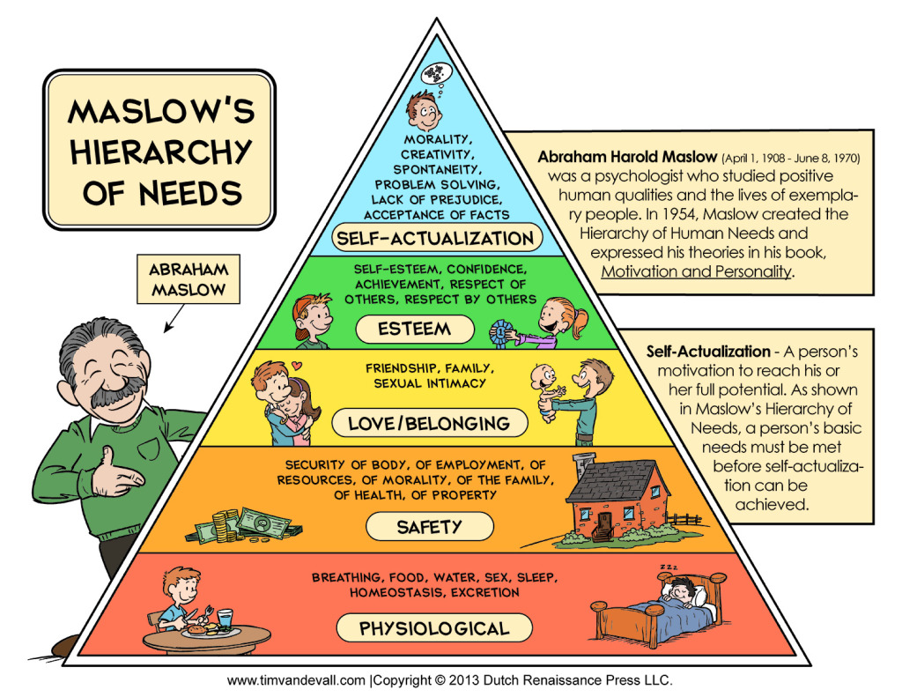

Slide 14
Characteristics of Needs
The lower the need is in the hierarchy, the greater is its strength, potency, and priority. The higher needs are weaker needs.
Higher needs appear later in life. Physiological and safety needs arise in infancy. Belongingness and esteem needs arise in adolescence. The need for self-actualization does not arise until midlife.
Because higher needs are less necessary for actual survival, their gratification can be postponed.
Failure to satisfy a higher need does not produce a crisis.
Failure to satisfy a lower need, on the other hand, does produce a crisis.
For this reason, Maslow called lower needs deficit, or deficiency, needs; failure to satisfy them produces a deficit or lack in the individual.

Slide 15
Characteristics of Needs
Although higher needs are less necessary for survival, they can contribute to our personal growth. Satisfaction of higher needs leads to improved health, happiness, contentment, fulfillment, and longevity.
For this reason, Maslow called higher needs growth or being needs.
Gratification of higher needs requires better external social, economic, and political circumstances than does gratification of lower needs.
For example, pursuing self-actualization requires greater freedom of expression and opportunity than pursuing safety needs.
A need does not have to be satisfied fully before the next need in the hierarchy becomes important.
Maslow proposed a declining percentage of satisfaction for each need.
Offering a hypothetical example, he described a person who satisfied, in turn, 85 percent of the physiological needs, 70 percent of the safety needs, 50 percent of the belongingness and love needs, 40 percent of the esteem needs, and 10 percent of the self-actualization need.

Slide 16
Conditions for achieving self-actualization
The following conditions are necessary in order for us to satisfy the self-actualization
need:
We must be free of constraints imposed by society and by ourselves.
We must not be distracted by the lower-order needs.
We must be secure in our self-image and in our relationships with other people, and we must be able to love and be loved in return.
We must have a realistic knowledge of our strengths and weaknesses, virtues and vices.

Slide 17
The Study of Self-Actualizers
According to Maslow’s theory, self-actualizers differ from others in terms of their basic motivation.
Maslow proposed a distinct type of motivation for self-actualizers which he called metamotivation (sometimes called B-motivation or Being).
The prefix metameans after or beyond. Metamotivation, then, indicates that it goes beyond psychology’s traditional idea of motivation.
Metamotivations involves maximizing personal potential rather than striving for a particular goal object.
Having explained that self-actualizers are thus, in a sense, unmotivated, Maslow proposed a list of metaneeds toward which self-actualizers evolve.
Metaneeds are states of being—such as goodness, uniqueness, and perfection—rather than specific goal objects.
Failure to satisfy metaneeds is harmful and produces a kind of metapathology, which thwarts the full development of the personality.
Metapathology prevents self-actualizers from expressing, using, and fulfilling their potential. They may come to feel helpless and depressed, unable to pinpoint a source for these feelings or identify a goal that might alleviate the distress.

Slide 19
Who are self-actualizers?
An efficient perception of reality
An acceptance of themselves, others, and nature.
A spontaneity, simplicity, and naturalness.
A focus on problems outside themselves.
A sense of detachment and the need for privacy.
A freshness of appreciation.
Mystical or peak experiences.
Self-actualizers know moments of intense ecstasy, not unlike deep religious experiences, that can occur with virtually any activity.
Maslow called these events peak experiences, during which the self is transcended and the person feels supremely powerful, confident, and decisive.

Slide 20
Personality Assessments
The Personal Orientation Inventory (POI), a self-report questionnaire consisting of 150 pairs of statements, was developed by psychologist Everett Shostrom (1964, 1974) to measure self-actualization.
People taking the test must indicate which of each pair is more applicable to them.
The POI is scored for 2 major scales and 10 subscales. The major scales are time competence, which measures the degree to which we live in the present, and inner directedness, which assesses how much we depend on ourselves rather than on others for judgments and values.
The Smartphone Basic Needs Scale is a 20-item self-report inventory designed to assess the degree to which smartphone use can satisfy the needs in Maslow’s system.
It was developed using college students in the United States and in South Korea as subjects, and the developers reported high levels of validity and reliability (Kang & Jung, 2014).

Slide 22
Self-Determination Theory
A contemporary outgrowth of the essence of Maslow’s self-actualization theory is the self-determination theory, which suggests that people have an innate tendency to express their interests, to exercise and develop their capabilities and potentials, and to overcome challenges (Deci & Ryan, 2009; Ryan & Deci, 2000; Deci & Ryan, 2012).
Research supporting the notion of self-determination has come from diverse groups such as football players in Australia, teenagers in India and Nigeria, and older women in the United States.
Those who scored highest in self-determination showed the greatest improvement in overall behavior and subjective well-being (Deci, 2011; Podlog & Eklund, 2010; Sheldon, Abad, & Omoile, 2009; Stephan, Boiche, & LeScanff, 2010).
More recent research studying people in the United States, Belgium, China, Peru, Australia, Mexico, Venezuela, the Philippines, Malaysia, and Japan have provided further support for the role of self-determination in facilitating positive growth needs and self-actualization (Chen et al., 2014; Church et al., 2013).

Slide 23
Self-Determination Theory
Self-determination is facilitated by a person’s focus on intrinsic motivation, such as engaging in an activity solely because of the interest and challenge of the activity itself.
Extrinsic motivation, on the other hand, involves engaging in some activity only for the sake of some external reward such as praise, a promotion or pay raise, or a higher grade.
There is a basic similarity between the notions of intrinsic motivation and self-determination, and Maslow’s description of self-actualization. Both are concerned with fulfilling or realizing one’s talents and abilities for the goal of inner satisfaction rather than any kind of external reward.
Three Basic Needs → Self-determination theory specifies three basic needs; it is through the satisfaction of these needs that a person can reach a state of well-being.
Competence—the need to feel that one can master difficult tasks
Autonomy—the freedom to base one’s course of action on one’s own interests, needs, and values
Relatedness—the need to feel a close connection with other people

